Slide 1

Chapter Eleven
Planning and Learning

Slide 2
Learning objectives.
11.1 Introduction
11.2 Language of planning problem
11.3 Example of Air Cargo
11.4 The spare tire problem
11.5 Planning with state space
11.6 Partial order planning
11.7 Hierarchical planning
11.8 Conditional planning
11.9 Learning decision trees
11.10 Ensemble learning
11.11 Reinforcement learning
After this chapter , students will be able to :
Learning the concept of Planning
Use of planning algorithm in real world problem
Understand the concept and implementation of various planning types

Slide 3
What is planning?
11.1 Introduction
11.2 Language of planning problem
11.3 Example of Air Cargo
11.4 The spare tire problem
11.5 Planning with state space
11.6 Partial order planning
11.7 Hierarchical planning
11.8 Conditional planning
11.9 Learning decision trees
11.10 Ensemble learning
11.11 Reinforcement learning
We have some Operators.
We have a Current state.
We have a Goal State.
We want to know:
How to arrange the operators to reach the Goal State from Current State.

Slide 4
Introduction
11.1 Introduction
11.2 Language of planning problem
11.3 Example of Air Cargo
11.4 The spare tire problem
11.5 Planning with state space
11.6 Partial order planning
11.7 Hierarchical planning
11.8 Conditional planning
11.9 Learning decision trees
11.10 Ensemble learning
11.11 Reinforcement learning
In planning we see how an agent can take advantage of the structure of a problem to construct complex plans of action.
The planning problem in Artificial Intelligence is about the decision making performed by intelligent creatures like robots, humans, or computer programs when trying to achieve some goal.
The task of coming up with a sequence of actions that will achieve a goal is known as planning.

Slide 5
Planning problem
11.1 Introduction
11.2 Language of planning problem
11.3 Example of Air Cargo
11.4 The spare tire problem
11.5 Planning with state space
11.6 Partial order planning
11.7 Hierarchical planning
11.8 Conditional planning
11.9 Learning decision trees
11.10 Ensemble learning
11.11 Reinforcement learning
Find a sequence of actions that achieves a given goal when executed from a given initial world state. That is, given
a set of operator descriptions (defining the possible primitive actions by the agent),
an initial state description, and
a goal state description or predicate,
compute a plan, which is
a sequence of operator instances, such that executing them in the initial state will change the world to a state satisfying the goal-state description.
Goals are usually specified as a conjunction of goals to be achieved

Slide 6
Planning vs. problem solving
11.1 Introduction
11.2 Language of planning problem
11.3 Example of Air Cargo
11.4 The spare tire problem
11.5 Planning with state space
11.6 Partial order planning
11.7 Hierarchical planning
11.8 Conditional planning
11.9 Learning decision trees
11.10 Ensemble learning
11.11 Reinforcement learning
Planning and problem solving methods can often solve the same sorts of problems
Planning is more powerful because of the representations and methods used
States, goals, and actions are decomposed into sets of sentences (usually in first-order logic)
Search often proceeds through plan space rather than state space (though there are also state-space planners)
Subgoals can be planned independently, reducing the complexity of the planning problem

Slide 7
Typical assumptions
11.1 Introduction
11.2 Language of planning problem
11.3 Example of Air Cargo
11.4 The spare tire problem
11.5 Planning with state space
11.6 Partial order planning
11.7 Hierarchical planning
11.8 Conditional planning
11.9 Learning decision trees
11.10 Ensemble learning
11.11 Reinforcement learning
Atomic time: Each action is indivisible
No concurrent actions are allowed (though actions do not need to be ordered with respect to each other in the plan)
Deterministic actions: The result of actions are completely determined—there is no uncertainty in their effects
Agent is the sole cause of change in the world
Agent is omniscient: Has complete knowledge of the state of the world
Closed World Assumption: everything known to be true in the world is included in the state description. Anything not listed is false.

Slide 8
Blocks world
11.1 Introduction
11.2 Language of planning problem
11.3 Example of Air Cargo
11.4 The spare tire problem
11.5 Planning with state space
11.6 Partial order planning
11.7 Hierarchical planning
11.8 Conditional planning
11.9 Learning decision trees
11.10 Ensemble learning
11.11 Reinforcement learning
The blocks world is a micro-world that consists of a table, a set of blocks and a robot hand.
Some domain constraints:
Only one block can be on another block
Any number of blocks can be on the table
The hand can only hold one block
Typical representation:
ontable(A)
ontable(C)
on(B,A)
handempty
clear(B)
clear(C)
B
A
C
TABLE

Slide 9
General Problem Solver
11.1 Introduction
11.2 Language of planning problem
11.3 Example of Air Cargo
11.4 The spare tire problem
11.5 Planning with state space
11.6 Partial order planning
11.7 Hierarchical planning
11.8 Conditional planning
11.9 Learning decision trees
11.10 Ensemble learning
11.11 Reinforcement learning
The General Problem Solver (GPS) system was an early planner (Newell, Shaw, and Simon)
GPS generated actions that reduced the difference between some state and a goal state
GPS used Means-Ends Analysis
Compare what is given or known with what is desired and select a reasonable thing to do next
Use a table of differences to identify procedures to reduce types of differences
GPS was a state space planner: it operated in the domain of state space problems specified by an initial state, some goal states, and a set of operations

Slide 10
Situation calculus planning
11.1 Introduction
11.2 Language of planning problem
11.3 Example of Air Cargo
11.4 The spare tire problem
11.5 Planning with state space
11.6 Partial order planning
11.7 Hierarchical planning
11.8 Conditional planning
11.9 Learning decision trees
11.10 Ensemble learning
11.11 Reinforcement learning
Intuition: Represent the planning problem using first-order logic
Situation calculus lets us reason about changes in the world
Use theorem proving to “prove” that a particular sequence of actions, when applied to the situation characterizing the world state, will lead to a desired result

Slide 11
Situation calculus
11.1 Introduction
11.2 Language of planning problem
11.3 Example of Air Cargo
11.4 The spare tire problem
11.5 Planning with state space
11.6 Partial order planning
11.7 Hierarchical planning
11.8 Conditional planning
11.9 Learning decision trees
11.10 Ensemble learning
11.11 Reinforcement learning
Initial state: a logical sentence about (situation) S₀
At(Home, S₀) ^ ~Have(Milk, S₀) ^ ~ Have(Bananas, S₀) ^ ~Have(Drill, S₀)
Goal state:
(∃s) At(Home,s) ^ Have(Milk,s) ^ Have(Bananas,s) ^ Have(Drill,s)
Operators are descriptions of how the world changes as a result of the agent’s actions:
∀(a,s) Have(Milk,Result(a,s)) <=> ((a=Buy(Milk) ^ At(Grocery,s)) ∨ (Have(Milk, s) ^ a~=Drop(Milk)))
Result(a,s) names the situation resulting from executing action a in situation s.
Action sequences are also useful: Result'(l,s) is the result of executing the list of actions (l) starting in s:
(∀s) Result'([],s) = s
(∀a,p,s) Result'([a|p]s) = Result'(p,Result(a,s))

Slide 12
Situation calculus II
11.1 Introduction
11.2 Language of planning problem
11.3 Example of Air Cargo
11.4 The spare tire problem
11.5 Planning with state space
11.6 Partial order planning
11.7 Hierarchical planning
11.8 Conditional planning
11.9 Learning decision trees
11.10 Ensemble learning
11.11 Reinforcement learning
A solution is a plan that when applied to the initial state yields a situation satisfying the goal query:
At(Home,Result'(p,S₀))
^ Have(Milk,Result'(p,S₀))
^ Have(Bananas,Result'(p,S₀))
^ Have(Drill,Result'(p,S₀))
Thus we would expect a plan (i.e., variable assignment through unification) such as:
p = [Go(Grocery), Buy(Milk), Buy(Bananas), Go(HardwareStore), Buy(Drill), Go(Home)]

Slide 13
Situation calculus: Blocks world
11.1 Introduction
11.2 Language of planning problem
11.3 Example of Air Cargo
11.4 The spare tire problem
11.5 Planning with state space
11.6 Partial order planning
11.7 Hierarchical planning
11.8 Conditional planning
11.9 Learning decision trees
11.10 Ensemble learning
11.11 Reinforcement learning
Here’s an example of a situation calculus rule for the blocks world:
Clear (X, Result(A,S)) ↔ [Clear (X, S) ∧ (¬(A=Stack(Y,X) ∨ A=Pickup(X)) ∨ (A=Stack(Y,X) ∧ ¬(holding(Y,S)) ∨ (A=Pickup(X) ∧ ¬(handempty(S) ∧ ontable(X,S) ∧ clear(X,S))))] ∨ [A=Stack(X,Y) ∧ holding(X,S) ∧ clear(Y,S)] ∨ [A=Unstack(Y,X) ∧ on(Y,X,S) ∧ clear(Y,S) ∧ handempty(S)] ∨ [A=Putdown(X) ∧ holding(X,S)]
English translation: A block is clear if (a) in the previous state it was clear and we didn’t pick it up or stack something on it successfully, or (b) we stacked it on something else successfully, or (c) something was on it that we unstacked successfully, or (d) we were holding it and we put it down.
Whew!!! There’s gotta be a better way!

Slide 14
Situation calculus planning: Analysis
11.1 Introduction
11.2 Language of planning problem
11.3 Example of Air Cargo
11.4 The spare tire problem
11.5 Planning with state space
11.6 Partial order planning
11.7 Hierarchical planning
11.8 Conditional planning
11.9 Learning decision trees
11.10 Ensemble learning
11.11 Reinforcement learning
This is fine in theory, but remember that problem solving (search) is exponential in the worst case
Also, resolution theorem proving only finds a proof (plan), not necessarily a good plan
So we restrict the language and use a special-purpose algorithm (a planner) rather than general theorem prover

Slide 15
Basic representations for planning
11.1 Introduction
11.2 Language of planning problem
11.3 Example of Air Cargo
11.4 The spare tire problem
11.5 Planning with state space
11.6 Partial order planning
11.7 Hierarchical planning
11.8 Conditional planning
11.9 Learning decision trees
11.10 Ensemble learning
11.11 Reinforcement learning
Classic approach first used in the STRIPS planner circa 1970
States represented as a conjunction of ground literals
at(Home) ^ ~have(Milk) ^ ~have(bananas) ...
Goals are conjunctions of literals, but may have variables which are assumed to be existentially quantified
at(x) ^ have(Milk) ^ have(bananas) ...
Do not need to fully specify state
Non-specified either don’t-care or assumed false
Represent many cases in small storage
Often only represent changes in state rather than entire situation
Unlike theorem prover, not seeking whether the goal is true, but is there a sequence of actions to attain it

Slide 16
Operator/action representation
Operators contain three components:
Action description
Precondition - conjunction of positive literals
Effect - conjunction of positive or negative literals which describe how situation changes when operator is applied
Example:
Op[Action: Go(there),
Precond: At(here) ^ Path(here,there),
Effect: At(there) ^ ~At(here)]
All variables are universally quantified
Situation variables are implicit
preconditions must be true in the state immediately before operator is applied; effects are true immediately after
At(here) ,Path(here,there)
Go(there)
At(there) , ~At(here)

Slide 17
Blocks world operators
11.1 Introduction
11.2 Language of planning problem
11.3 Example of Air Cargo
11.4 The spare tire problem
11.5 Planning with state space
11.6 Partial order planning
11.7 Hierarchical planning
11.8 Conditional planning
11.9 Learning decision trees
11.10 Ensemble learning
11.11 Reinforcement learning
Here are the classic basic operations for the blocks world:
stack(X,Y): put block X on block Y
unstack(X,Y): remove block X from block Y
pickup(X): pickup block X
putdown(X): put block X on the table
Each will be represented by
a list of preconditions
a list of new facts to be added (add-effects)
a list of facts to be removed (delete-effects)
optionally, a set of (simple) variable constraints
For example:
preconditions(stack(X,Y), [holding(X),clear(Y)])
deletes(stack(X,Y), [holding(X),clear(Y)]).
adds(stack(X,Y), [handempty,on(X,Y),clear(X)])
constraints(stack(X,Y), [X\==Y,Y\==table,X\==table])

Slide 18
Blocks world operators II
11.1 Introduction
11.2 Language of planning problem
11.3 Example of Air Cargo
11.4 The spare tire problem
11.5 Planning with state space
11.6 Partial order planning
11.7 Hierarchical planning
11.8 Conditional planning
11.9 Learning decision trees
11.10 Ensemble learning
11.11 Reinforcement learning
operator(stack(X,Y),
Precond [holding(X),clear(Y)],
Add [handempty,on(X,Y),clear(X)],
Delete [holding(X),clear(Y)],
Constr [X\==Y,Y\==table,X\==table]).
operator(pickup(X),
[ontable(X), clear(X), handempty],
[holding(X)],
[ontable(X),clear(X),handempty],
[X\==table]).
operator(unstack(X,Y),
Pre [on(X,Y), clear(X), handempty],
ADD[holding(X),clear(Y)],
Del [handempty,clear(X),on(X,Y)],
[X\==Y,Y\==table,X\==table]).
operator(putdown(X),
[holding(X)],
[ontable(X),handempty,clear(X)],
[holding(X)],
[X\==table]).

Slide 19
STRIPS planning
11.1 Introduction
11.2 Language of planning problem
11.3 Example of Air Cargo
11.4 The spare tire problem
11.5 Planning with state space
11.6 Partial order planning
11.7 Hierarchical planning
11.8 Conditional planning
11.9 Learning decision trees
11.10 Ensemble learning
11.11 Reinforcement learning
STRIPS maintains two additional data structures:
State List - all currently true predicates.
Goal Stack - a push down stack of goals to be solved, with current goal on top of stack.
If current goal is not satisfied by present state, examine add lists of operators, and push operator and preconditions list on stack. (Subgoals)
When a current goal is satisfied, POP it from stack.
When an operator is on top stack, record the application of that operator on the plan sequence and use the operator’s add and delete lists to update the current state.

Slide 20
11.1 Introduction
11.2 Language of planning problem
11.3 Example of Air Cargo
11.4 The spare tire problem
11.5 Planning with state space
11.6 Partial order planning
11.7 Hierarchical planning
11.8 Conditional planning
11.9 Learning decision trees
11.10 Ensemble learning
11.11 Reinforcement learning
CLEAR(B)
ON(C,A)
CLEAR(C)
ONTABLE(A)
ONTABLE(B)
HANDEMPTY
UNSTACK(x,y)
P & D: HANDEMPTY,
CLEAR(x), ON(x,y)
A: HOLDING(x),
CLEAR(y)
CLEAR(A)
CLEAR(B)
HOLDING(C)
ONTABLE(A)
ONTABLE(B)
PUTDOWN(x)
P & D: HOLDING(x)
A: ONTABLE(x),
CLEAR(x),
HANDEMPTY

Slide 21
11.1 Introduction
11.2 Language of planning problem
11.3 Example of Air Cargo
11.4 The spare tire problem
11.5 Planning with state space
11.6 Partial order planning
11.7 Hierarchical planning
11.8 Conditional planning
11.9 Learning decision trees
11.10 Ensemble learning
11.11 Reinforcement learning
CLEAR(A)
CLEAR(B)
ONTABLE(A)
ONTABLE(B)
ONTABLE(C)
CLEAR(C)
HANDEMPTY
PICKUP(x)
P & D: ONTABLE(x),
CLEAR(x), HANDEMPTY
A: HOLDING(x)
CLEAR(A)
ONTABLE(A)
ONTABLE(C)
CLEAR(C)
HOLDING(B)
STACK(x,y)
P & D: HOLDING(x),
CLEAR(y)
A: HANDEMPTY, ON(x,y), CLEAR(x)
etc.

Slide 22
The original STRIPS system used a goal stack to control its search.
11.1 Introduction
11.2 Language of planning problem
11.3 Example of Air Cargo
11.4 The spare tire problem
11.5 Planning with state space
11.6 Partial order planning
11.7 Hierarchical planning
11.8 Conditional planning
11.9 Learning decision trees
11.10 Ensemble learning
11.11 Reinforcement learning
The system has a database and a goal stack, and it focuses attention on solving the top goal (which may involve solving sub-goals, which are then pushed onto the stack, etc.)

Slide 23
The basic idea
11.1 Introduction
11.2 Language of planning problem
11.3 Example of Air Cargo
11.4 The spare tire problem
11.5 Planning with state space
11.6 Partial order planning
11.7 Hierarchical planning
11.8 Conditional planning
11.9 Learning decision trees
11.10 Ensemble learning
11.11 Reinforcement learning
Place goal in goal stack:
Goal1
Considering top Goal1,
place onto it its sub-goals:
GoalS1-2
GoalS1-1
Goal1
Then try to solve sub-goal
GoalS1-2, and continue…

Slide 24
Stack Manipulation Rules I
11.1 Introduction
11.2 Language of planning problem
11.3 Example of Air Cargo
11.4 The spare tire problem
11.5 Planning with state space
11.6 Partial order planning
11.7 Hierarchical planning
11.8 Conditional planning
11.9 Learning decision trees
11.10 Ensemble learning
11.11 Reinforcement learning
If on top of goal stack
Compound or single goal matching the current state description
Compound goal not matching the current state description
Than do:
Remove it
1. Keep original compound goal on stack;
2. List the unsatisfied component goals on the stack in some new order

Slide 25
Stack Manipulation Rules II
11.1 Introduction
11.2 Language of planning problem
11.3 Example of Air Cargo
11.4 The spare tire problem
11.5 Planning with state space
11.6 Partial order planning
11.7 Hierarchical planning
11.8 Conditional planning
11.9 Learning decision trees
11.10 Ensemble learning
11.11 Reinforcement learning
If on top of goal stack
Single-literal goal not matching the current state description.
Rule
Than do:
Find new rule whose instantiated add-list includes the goal, and
1. Replace the goal with the instantiated rule;
2. Place the rule’s instantiated precondition formula on top of stack
1. Remove rule from stack;
2. Update database using rule;
3. Keep track of rule (for solution)
Nothing
Stop

Slide 26
11.1 Introduction
11.2 Language of planning problem
11.3 Example of Air Cargo
11.4 The spare tire problem
11.5 Planning with state space
11.6 Partial order planning
11.7 Hierarchical planning
11.8 Conditional planning
11.9 Learning decision trees
11.10 Ensemble learning
11.11 Reinforcement learning
Example
Goal state
Initial state
A
C
C
A
B
B
1. Place on stack original
goal:
Stack:
On(A,C) & On(C,B)
CLEAR(B)
ON(C,A)
CLEAR(C)
ONTABLE(A)
ONTABLE(B)
HANDEMPTY
Database:

Slide 27
11.1 Introduction
11.2 Language of planning problem
11.3 Example of Air Cargo
11.4 The spare tire problem
11.5 Planning with state space
11.6 Partial order planning
11.7 Hierarchical planning
11.8 Conditional planning
11.9 Learning decision trees
11.10 Ensemble learning
11.11 Reinforcement learning
Example
2. Since top goal is unsatisfied compound goal, list its unsatisfied subgoals on top of it:
On(C,B)
Stack:
On(A,C)
On(A,C) & On(C,B)
CLEAR(B)
ON(C,A)
CLEAR(C)
ONTABLE(A)
ONTABLE(B)
HANDEMPTY
Database
(unchanged):

Slide 28
11.1 Introduction
11.2 Language of planning problem
11.3 Example of Air Cargo
11.4 The spare tire problem
11.5 Planning with state space
11.6 Partial order planning
11.7 Hierarchical planning
11.8 Conditional planning
11.9 Learning decision trees
11.10 Ensemble learning
11.11 Reinforcement learning
Example
3. Since top goal is unsatisfied single-literal goal, find rule whose instantiated add-list includes the goal, and: a. Replace the goal with the instantiated rule; b. Place the rule’s instantiated precondition formula on top of stack
Holding(C) & Clear(B)
Stack:
stack(C,B)
On(C,B)
On(A,C)
On(A,C) & On(C,B)
CLEAR(B)
ON(C,A)
CLEAR(C)
ONTABLE(A)
ONTABLE(B)
HANDEMPTY
Database
(unchanged):

Slide 29
11.1 Introduction
11.2 Language of planning problem
11.3 Example of Air Cargo
11.4 The spare tire problem
11.5 Planning with state space
11.6 Partial order planning
11.7 Hierarchical planning
11.8 Conditional planning
11.9 Learning decision trees
11.10 Ensemble learning
11.11 Reinforcement learning
Example
4. Since top goal is unsatisfied compound goal, list its subgoals on top of it:
Clear(B)
Holding(C)
Stack:
Holding(C) & Clear(B)
stack(C,B)
On(A,C)
On(A,C) & On(C,B)
CLEAR(B)
ON(C,A)
CLEAR(C)
ONTABLE(A)
ONTABLE(B)
HANDEMPTY
Database
(unchanged):

Slide 30
11.1 Introduction
11.2 Language of planning problem
11.3 Example of Air Cargo
11.4 The spare tire problem
11.5 Planning with state space
11.6 Partial order planning
11.7 Hierarchical planning
11.8 Conditional planning
11.9 Learning decision trees
11.10 Ensemble learning
11.11 Reinforcement learning
Example
5. Single goal on top of stack matches data base, so remove it:
Clear(B)
Holding(C)
Stack:
Holding(C) & Clear(B)
stack(C,B)
On(A,C)
On(A,C) & On(C,B)
CLEAR(B)
ON(C,A)
CLEAR(C)
ONTABLE(A)
ONTABLE(B)
HANDEMPTY
Database
(unchanged):

Slide 31
11.1 Introduction
11.2 Language of planning problem
11.3 Example of Air Cargo
11.4 The spare tire problem
11.5 Planning with state space
11.6 Partial order planning
11.7 Hierarchical planning
11.8 Conditional planning
11.9 Learning decision trees
11.10 Ensemble learning
11.11 Reinforcement learning
Example
6. Since top goal is unsatisfied single-literal goal, find rule whose instantiated add-list includes the goal, and: a. Replace the goal with the instantiated rule; b. Place the rule’s instantiated precondition formula on top of stack
On(C,A) &Clear(C) & Handempty
unstack(C,A)
Holding(C)
Holding(C) & Clear(B)
stack(C,B)
Stack:
On(A,C)
On(A,C) &On(C,B)
Database: (unchanged)

Slide 32
11.1 Introduction
11.2 Language of planning problem
11.3 Example of Air Cargo
11.4 The spare tire problem
11.5 Planning with state space
11.6 Partial order planning
11.7 Hierarchical planning
11.8 Conditional planning
11.9 Learning decision trees
11.10 Ensemble learning
11.11 Reinforcement learning
Example
7. Compound goal on top of stack matches data base, so remove it:
On(C,A) &Clear(C) & Handempty
unstack(C,A)
Stack:
Holding(C) & Clear(B)
stack(C,B)
On(A,C)
On(A,C) &On(C,B)
CLEAR(B)
ON(C,A)
CLEAR(C)
ONTABLE(A)
ONTABLE(B)
HANDEMPTY
Database
(unchanged):

Slide 33
11.1 Introduction
11.2 Language of planning problem
11.3 Example of Air Cargo
11.4 The spare tire problem
11.5 Planning with state space
11.6 Partial order planning
11.7 Hierarchical planning
11.8 Conditional planning
11.9 Learning decision trees
11.10 Ensemble learning
11.11 Reinforcement learning
Example
8. Top item is rule, so:
a. Remove rule from stack;
b. Update database using rule;
c. Keep track of rule (for solution)
unstack(C,A)
Holding(C) & Clear(B)
Stack:
stack(C,B)
On(A,C)
On(A,C) &On(C,B)
Database:
unstack(X,Y):
Add - [holding(X),clear(Y)]
Delete -[handempty,clear(X),
on(X,Y)]
CLEAR(B)
ONTABLE(A)
ONTABLE(B)
HOLDING(C)
CLEAR(A)
Solution: {unstack(C,A)}

Slide 34
Example
9. Compound goal on top of stack matches data base, so remove it:
Holding(C) & Clear(B)
Stack:
stack(C,B)
On(A,C)
On(A,C) &On(C,B)
Database:
(unchanged)
CLEAR(B)
ONTABLE(A)
ONTABLE(B)
HOLDING(C)
CLEAR(A)
Solution: {unstack(C)}

Slide 35
Example
10. Top item is rule, so:
a. Remove rule from stack;
b. Update database using rule;
c. Keep track of rule (for solution)
stack(C,B)
On(A,C)
Stack:
On(A,C) &On(C,B)
ONTABLE(A)
ONTABLE(B)
HANDEMPTY
CLEAR(A)
CLEAR(C)
ON(C,B)
Database:
stack(X,Y):
Add - [handempty,on(X,Y),clear(X)]
Delete - [holding(X),clear(Y)]
Solution: {unstack(C), stack(C,B)}

Slide 36
Example
11. Since top goal is unsatisfied single-literal goal, find rule whose instantiated add-list includes the goal, and: a. Replace the goal with the instantiated rule; b. Place the rule’s instantiated precondition formula on top of stack
Holding(A) &Clear(C)
stack(A,C)
Stack:
On(A,C)
On(A,C) &On(C,B)
ONTABLE(A)
ONTABLE(B)
HANDEMPTY
CLEAR(A)
CLEAR(C)
ON(C,B)
Database:
(unchanged)
Solution: {unstack(C), stack(C,B)}

Slide 37
Example
12. Since top goal is unsatisfied compound goal, list its unsatisfied sub-goals on top of it:
Holding(A)
Stack:
Holding(A) &Clear(C)
stack(A,C)
On(A,C) &On(C,B)
ONTABLE(A)
ONTABLE(B)
HANDEMPTY
CLEAR(A)
CLEAR(C)
ON(C,B)
Database:
(unchanged)
Solution: {unstack(C), stack(C,B)}

Slide 38
Example
13. Since top goal is unsatisfied single-literal goal, find rule whose instantiated add-list includes the goal, and: a. Replace the goal with the instantiated rule; b. Place the rule’s instantiated precondition formula on top of stack
Ontable(A) &Clear(A) &Handempty
Stack:
pickup(A)
Holding(A) &Clear(C)
Holding(A)
stack(A,C)
On(A,C) &On(C,B)
Database:
(unchanged)
Solution: {unstack(C), stack(C,B)}

Slide 39
Example
14. Compound goal on top of stack matches data base, so remove it:
Ontable(A) &Clear(A) &Handempty
Stack:
pickup(A)
Holding(A) &Clear(C)
stack(A,C)
On(A,C) &On(C,B)
Database:
(unchanged)
ONTABLE(A)
ONTABLE(B)
HANDEMPTY
CLEAR(A)
CLEAR(C)
ON(C,B)
Solution: {unstack(C), stack(C,B)}

Slide 40
Example
15. Top item is rule, so:
a. Remove rule from stack;
b. Update database using rule;
c. Keep track of rule (for solution)
pickup(A)
Stack:
Holding(A) &Clear(C)
stack(A,C)
On(A,C) &On(C,B)
Database:
pickup(X):
Add - [holding(X)]
Delete - [ontable(X),clear(X),handempty]
ONTABLE(B)
ON(C,B)
CLEAR(C)
HOLDING(A)
Solution: {unstack(C), stack(C,B),pickup(A)}

Slide 41
Example
16. Compound goal on top of stack matches data base, so remove it:
Holding(A) &Clear(C)
Stack:
stack(A,C)
On(A,C) &On(C,B)
Database:
(unchanged)
ONTABLE(B)
ON(C,B)
CLEAR(C)
HOLDING(A)
Solution: {unstack(C), stack(C,B),pickup(A)}

Slide 42
Example
17. Top item is rule, so:
a. Remove rule from stack;
b. Update database using rule;
c. Keep track of rule (for solution)
Stack:
stack(A,C)
On(A,C) &On(C,B)
Database:
stack(X,Y):
Add - [handempty,on(X,Y),clear(X)]
Delete - [holding(X),clear(Y)]
ONTABLE(B)
ON(C,B)
ON(A,C)
CLEAR(A)
HANDEMPTY
Solution: {unstack(C), stack(C,B),pickup(A), stack(A,C)}

Slide 43
Example
18. Compound goal on top of stack matches data base, so remove it:
Stack:
On(A,C) &On(C,B)
Database:
stack(X,Y):
Add - [handempty,on(X,Y),clear(X)]
Delete - [holding(X),clear(Y)]
ONTABLE(B)
ON(C,B)
ON(A,C)
CLEAR(A)
HANDEMPTY
Solution: {unstack(C), stack(C,B),pickup(A), stack(A,C)}
19. Stack is empty, so stop.
Solution: {unstack(C), stack(C,B),pickup(A), stack(A,C)}

Slide 44
Example
Goal state
A
Initial state
C
C
A
B
B
In solving this problem, we took some shortcuts—we branched in the right direction every time.
In practice, searching can be guided by
1. Heuristic information (e.g., try to achieve “HOLDING(x)” last)
2. Detecting unprofitable paths (e.g., when the newest goal set has become a superset of the original goal set)
3. Considering useful operator side effects (by scanning down the stack).

Slide 45
Sussman Anomaly
Goal state
A
Initial state
C
B
A
B
C
I:
ON(C,A)
ONTABLE(A)
ONTABLE(B)
ARMEMPTY
G:
ON(A,B)
ON(B,C)
It could try ON(B,C) first, then ON(A,B)—but it will find that the first goal has been undone. So the first goal will be added back onto the stack and solved.

Slide 46
The final sequence is inefficient:
Sussman Anomaly
Initial state
PICKUP(B)
STACK(B,C)
UNSTACK(B,C)
PUTDOWN(B)
UNSTACK(C,A)
PUTDOWN(C)
PICKUP(A)
STACK(A,B)
UNSTACK(A,B)
PUTDOWN(A)
PICKUP(B)
STACK(B,C)
PICKUP(A)
STACK(A,B)
C
A
B
Goal state
A
B
C
1. Trying the goals in the other order doesn’t help much.
2. We can remove adjacent operators that undo each other.

Slide 47
What we really want is to:
1. Begin work on ON(A,B) by clearing A (i.e., putting C on table)
2. Achieve ON(B,C) by stacking B on C
3. Achieve [finish] ON(A,B) by stacking A on B.
Goal state
A
Initial state
C
B
A
B
C
We couldn’t do this using a stack, but we can if we use a set of goals.

Slide 48
STRIPS cannot solve all goals
Ex (from Nilsson, p. 305):
“We have two memory registers X and Y whose initial contents are A and B respectively.”
I: Contents(X,A) &Contents(Y,B)
We have one operation,
Assign(u,r,t,s) P: Contents(r,s)
D: Contents(u,t) A: Contents(u,s)
Our goal state is:
G: Contents(X,B) &Contents(Y,A)
STRIPS cannot defer its solution of either subgoal long enough not to erase the other register’s contents.

Slide 49
Language of planning problem
11.1 Introduction
11.2 Language of planning problem
11.3 Example of Air Cargo
11.4 The spare tire problem
11.5 Planning with state space
11.6 Partial order planning
11.7 Hierarchical planning
11.8 Conditional planning
11.9 Learning decision trees
11.10 Ensemble learning
11.11 Reinforcement learning
Representation of States: Planners decompose the world into the logical conditions and represent a state as a conjunction of positive literals. For example, prepositional literals are considered to be poor and unknown, which might represent the state of a hapless agent.
Representation of Goals: A goal is partially specified state, represented as a conjunction of positive ground literals.
Representation of Action: An action is particularised in terms of the preconditions that must hold before it can be executed and the effects that gaurantees when it is executed.

Slide 50
Example of Air Cargo
11.1 Introduction
11.2 Language of planning problem
11.3 Example of Air Cargo
11.4 The spare tire problem
11.5 Planning with state space
11.6 Partial order planning
11.7 Hierarchical planning
11.8 Conditional planning
11.9 Learning decision trees
11.10 Ensemble learning
11.11 Reinforcement learning
Example given shows an air cargo transport problem involving loading cargo on and off the planes arid flying it from place-to-place. The problem can be defined with the following three actions: load, unload and fly. The actions affect the following two predicates: In (c, p) implies that cargo c is inside plane p, and At (x, a) implies that object x (either plane or cargo) is at airport a. Note that, cargo is not anywhere when it is in a plane, therefore, At actually implies “available for use at a given location.” It accepts some experience with action definitions to handle such details consistently. The following plan is the representation of the problem as per STRIPS:
This representation is pure strips. Particularly, it allows a plane to fly to and from the same airport. In equality, literals in ADL could prevent this.

Slide 51
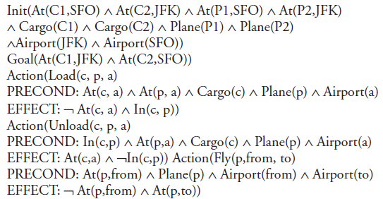
Example of Air Cargo
11.1 Introduction
11.2 Language of planning problem
11.3 Example of Air Cargo
11.4 The spare tire problem
11.5 Planning with state space
11.6 Partial order planning
11.7 Hierarchical planning
11.8 Conditional planning
11.9 Learning decision trees
11.10 Ensemble learning
11.11 Reinforcement learning

Slide 52
The spare tire problem
11.1 Introduction
11.2 Language of planning problem
11.3 Example of Air Cargo
11.4 The spare tire problem
11.5 Planning with state space
11.6 Partial order planning
11.7 Hierarchical planning
11.8 Conditional planning
11.9 Learning decision trees
11.10 Ensemble learning
11.11 Reinforcement learning
Consider the problem of changing a flat tire. Precisely, the goal is to have a good-spare tire mounted properly onto the car’s axle, where the initial state has a flat tire on the axle and a good spare tire is in the trunk.
To keep it simple, our version of the problem is a very abstract, with no complications. There are just the following four actions: removing the spare from the trunk, removing the flat tire from the axle, placing the spare on the axle, and leaving the car unattended overnight. It is assumed that the car is particularly in a bad neighbourhood. Therefore, the effect of leaving it overnight is that the tires disappear.

Slide 53

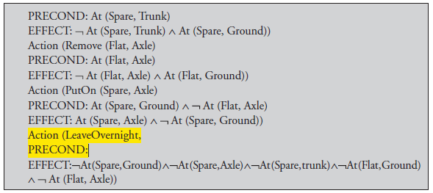
The spare tire problem
11.1 Introduction
11.2 Language of planning problem
11.3 Example of Air Cargo
11.4 The spare tire problem
11.5 Planning with state space
11.6 Partial order planning
11.7 Hierarchical planning
11.8 Conditional planning
11.9 Learning decision trees
11.10 Ensemble learning
11.11 Reinforcement learning

Slide 54
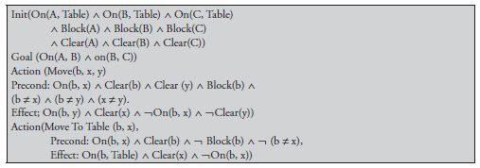
Planning with state space
11.1 Introduction
11.2 Language of planning problem
11.3 Example of Air Cargo
11.4 The spare tire problem
11.5 Planning with state space
11.6 Partial order planning
11.7 Hierarchical planning
11.8 Conditional planning
11.9 Learning decision trees
11.10 Ensemble learning
11.11 Reinforcement learning
1. Forward state-space search: Forward search is an algorithm that searches forward from the initial state of the world to try finding a state that satisfies the goal formula. It is sometimes known as progression planning. This is because it moves in the forward direction.

Slide 55
Planning with state space
11.1 Introduction
11.2 Language of planning problem
11.3 Example of Air Cargo
11.4 The spare tire problem
11.5 Planning with state space
11.6 Partial order planning
11.7 Hierarchical planning
11.8 Conditional planning
11.9 Learning decision trees
11.10 Ensemble learning
11.11 Reinforcement learning
Regression Algorithm
1. How to determine predecessors?
2. What are the states from which applying a given action leads to the goal?
Goal state = At(C1, B) ∧ At(C2, B) ∧ … ∧ A(C20, B)
Relevant action for first conjunct: Unload(C1, p, B)
Works only if pre-conditions are satisfied.
Previous state = In(C1, p) ∧ A(p, B) ∧ At(C2, B) ∧ … ∧ At(C20, B)
Subgoal At(C1, B) should not be present in this state.
3. Actions must not undo desired literals (consistent).
4. Main advantage: The only relevant actions are considered, often much lower branching factor than
forward search.

Slide 56
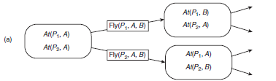
Planning with state space
11.1 Introduction
11.2 Language of planning problem
11.3 Example of Air Cargo
11.4 The spare tire problem
11.5 Planning with state space
11.6 Partial order planning
11.7 Hierarchical planning
11.8 Conditional planning
11.9 Learning decision trees
11.10 Ensemble learning
11.11 Reinforcement learning
5. General process for predecessor construction
Give a goal description G.
Let A be an action that is relevant and consistent.
The predecessor is as follows:
Any positive effects of A that appear in G are deleted.
Each precondition literal of A is added, unless it already appears.
6. Any standard search algorithm can be added to perform the search.
7. Termination: When predecessor is satisfied by initial state.
In FO case, satisfaction might require a substitution..

Slide 57
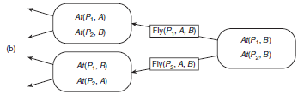
Planning with state space
11.1 Introduction
11.2 Language of planning problem
11.3 Example of Air Cargo
11.4 The spare tire problem
11.5 Planning with state space
11.6 Partial order planning
11.7 Hierarchical planning
11.8 Conditional planning
11.9 Learning decision trees
11.10 Ensemble learning
11.11 Reinforcement learning
2. Backward state-space search
Backward search can be difficult to implement when the goal state is described by set of constraints rather than being listed explicitly. In particular, it is not always obvious how to generate a description of the possible predecessors of the set of goal states.
The main advantages of the backward search are that it allows considering only relevant actions. An action is relevant to a conjunctive goal if it achieves one of the conjuncts of the goal.

Slide 58
Planning with state space
11.1 Introduction
11.2 Language of planning problem
11.3 Example of Air Cargo
11.4 The spare tire problem
11.5 Planning with state space
11.6 Partial order planning
11.7 Hierarchical planning
11.8 Conditional planning
11.9 Learning decision trees
11.10 Ensemble learning
11.11 Reinforcement learning
Progression Algorithm
1. Formulation as the state–space search problem:
Initial state = initial state of the planning problem
Literals not appearing are false.
Actions = those whose preconditions are satisfied
Add positive effects, delete the negative effects.
Goal test = does the state satisfy the goal
Step cost = each action costs 1
2. No functions … any graph search that is complete is a complete planning algorithm.
3. Inefficient: (a) irrelevant action problem (b) good heuristic required for efficient search.

Slide 59
Planning with state space
11.1 Introduction
11.2 Language of planning problem
11.3 Example of Air Cargo
11.4 The spare tire problem
11.5 Planning with state space
11.6 Partial order planning
11.7 Hierarchical planning
11.8 Conditional planning
11.9 Learning decision trees
11.10 Ensemble learning
11.11 Reinforcement learning
3. Heuristic for State–Space Search
It turns out that neither forward nor backward search is efficient without a good heuristic function. A heuristic function estimates the distance from a state to the goal in strips planning. The cost of each action comes to be 1, so the distance is the number of actions. The basic idea is to look at the effects of action and at the goals that must be achieved and to guess how many actions are required to attain the goals.

Slide 60
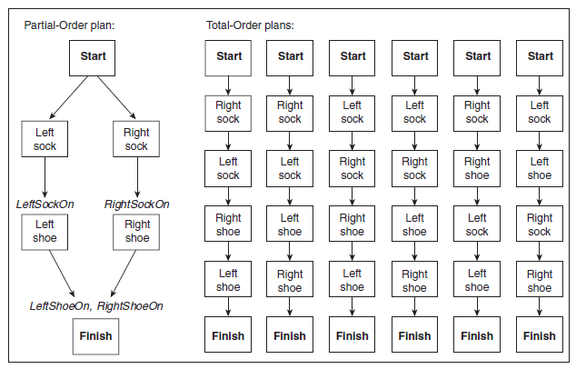
Partial order planning
11.1 Introduction
11.2 Language of planning problem
11.3 Example of Air Cargo
11.4 The spare tire problem
11.5 Planning with state space
11.6 Partial order planning
11.7 Hierarchical planning
11.8 Conditional planning
11.9 Learning decision trees
11.10 Ensemble learning
11.11 Reinforcement learning
Any planning algorithm that can place two actions into a plan without specifying when comes first are called partial-order planner. The partial order solution corresponds to six possible total order plans; each of these is called a linearisation of the partial-order plan.

Slide 61
Hierarchical planning
11.1 Introduction
11.2 Language of planning problem
11.3 Example of Air Cargo
11.4 The spare tire problem
11.5 Planning with state space
11.6 Partial order planning
11.7 Hierarchical planning
11.8 Conditional planning
11.9 Learning decision trees
11.10 Ensemble learning
11.11 Reinforcement learning
In AI, the hierarchical task network (HTN) planning is an approach to automated planning in which the dependency among actions can be given in the form of hierarchically structured networks.
Planning problems are specified in the hierarchical task network approach by providing a set of tasks, which can be:
1. Primitive tasks, which roughly correspond to the actions of STRIPS;
2. Compound tasks, which can be seen as composed of a set of simpler tasks;
3. Goal tasks, which roughly correspond to the goals of STRIPS, but are more general. A solution to an HTN problem is an executable sequence of primitive tasks that can be obtained from the initial task network by decomposing compound tasks into their set of simpler tasks and by inserting ordering constraints.

Slide 62
Conditional planning
11.1 Introduction
11.2 Language of planning problem
11.3 Example of Air Cargo
11.4 The spare tire problem
11.5 Planning with state space
11.6 Partial order planning
11.7 Hierarchical planning
11.8 Conditional planning
11.9 Learning decision trees
11.10 Ensemble learning
11.11 Reinforcement learning
Conditional planning is a method to deal with uncertainty by inspecting what is actually happening in the environment at the predetermined points in the plans. Conditional planning is simplest to explain the fully observable environments. So, the explanation will start with that case. The partially observable case is more difficult, but much interesting.
Conditional Planning in Fully Observable Environments
Conditional Planning in Partially Observable Environments

Slide 63
Learning decision trees
11.1 Introduction
11.2 Language of planning problem
11.3 Example of Air Cargo
11.4 The spare tire problem
11.5 Planning with state space
11.6 Partial order planning
11.7 Hierarchical planning
11.8 Conditional planning
11.9 Learning decision trees
11.10 Ensemble learning
11.11 Reinforcement learning
Decision tree induction is one of the simplest, and yet most successful forms of learning algorithm. It serves as a good introduction to the area of inductive learning, and it is easy to implement. The performance element is describes and then it is showed how to learn.
Decision Trees as Performance Elements
Expressiveness of Decision Trees
Inducing Decision Trees from Examples

Slide 64
What is Learning?
11.1 Introduction
11.2 Language of planning problem
11.3 Example of Air Cargo
11.4 The spare tire problem
11.5 Planning with state space
11.6 Partial order planning
11.7 Hierarchical planning
11.8 Conditional planning
11.9 Learning decision trees
11.10 Ensemble learning
11.11 Reinforcement learning
“Learning denotes changes in a system that ... enable a system to do the same task more efficiently the next time.” -- Herbert Simon
“Learning is constructing or modifying representations of what is being experienced.” -- Ryszard Michalski
“Learning is making useful changes in our minds.” -- Marvin Minsky

Slide 65
Why Learn?
11.1 Introduction
11.2 Language of planning problem
11.3 Example of Air Cargo
11.4 The spare tire problem
11.5 Planning with state space
11.6 Partial order planning
11.7 Hierarchical planning
11.8 Conditional planning
11.9 Learning decision trees
11.10 Ensemble learning
11.11 Reinforcement learning
Understand and improve efficiency of human learning
Use to improve methods for teaching and tutoring people (e.g., better computer-aided instruction.)
Discover new things or structures that are unknown to humans
Example: Data mining, Knowledge Discovery in Databases
Fill in skeletal or incomplete specifications about a domain
Large, complex AI systems cannot be completely derived by hand and require dynamic updating to incorporate new information.
Learning new characteristics expands the domain or expertise and lessens the "brittleness" of the system
Build software agents that can adapt to their users, to other software agents, and to the changing environment.

Slide 66
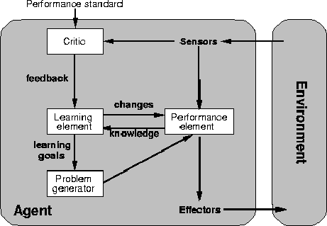
A General Model of Learning Agents
11.1 Introduction
11.2 Language of planning problem
11.3 Example of Air Cargo
11.4 The spare tire problem
11.5 Planning with state space
11.6 Partial order planning
11.7 Hierarchical planning
11.8 Conditional planning
11.9 Learning decision trees
11.10 Ensemble learning
11.11 Reinforcement learning

Slide 67
Major Paradigms of Machine Learning
11.1 Introduction
11.2 Language of planning problem
11.3 Example of Air Cargo
11.4 The spare tire problem
11.5 Planning with state space
11.6 Partial order planning
11.7 Hierarchical planning
11.8 Conditional planning
11.9 Learning decision trees
11.10 Ensemble learning
11.11 Reinforcement learning
Rote Learning -- One-to-one mapping from inputs to stored representation. "Learning by memorization.” Association-based storage and retrieval.
Clustering
Analogue -- Determine correspondence between two different representations
Induction -- Use specific examples to reach general conclusions
Discovery -- Unsupervised, specific goal not given
Genetic Algorithms
Neural Networks
Reinforcement -- Feedback (positive or negative reward) given at end of a sequence of steps.
Assign reward to steps by solving the credit assignment problem--which steps should receive credit or blame for a final result?

Slide 68
The Inductive Learning Problem
11.1 Introduction
11.2 Language of planning problem
11.3 Example of Air Cargo
11.4 The spare tire problem
11.5 Planning with state space
11.6 Partial order planning
11.7 Hierarchical planning
11.8 Conditional planning
11.9 Learning decision trees
11.10 Ensemble learning
11.11 Reinforcement learning
Induce rules that extrapolate from a given set of examples to make “accurate” predictions about future examples.
Supervised versus Unsupervised learning
Learn an unknown function f(X) = Y, where X is an input example and Y is the desired output.
Supervised learning implies we are given a training set of (X, Y) pairs by a "teacher."
Unsupervised learning means we are only given the Xs and some (ultimate) feedback function on our performance.
Concept learning or Classification
Given a set of examples of some concept/class/category, determine if a given example is an instance of the concept or not.
If it is an instance, we call it a positive example.
If it is not, it is called a negative example.

Slide 69
Supervised Concept Learning
11.1 Introduction
11.2 Language of planning problem
11.3 Example of Air Cargo
11.4 The spare tire problem
11.5 Planning with state space
11.6 Partial order planning
11.7 Hierarchical planning
11.8 Conditional planning
11.9 Learning decision trees
11.10 Ensemble learning
11.11 Reinforcement learning
Given a training set of positive and negative examples of a concept
Usually each example has a set of features/attributes
Construct a description that will accurately classify whether future examples are positive or negative.
That is, learn some good estimate of function f given a training set {(x1, y1), (x2, y2), ..., (xn, yn)} where each yi is either + (positive) or - (negative).
f is a function of the features/attributes

Slide 70
Inductive Learning Framework
11.1 Introduction
11.2 Language of planning problem
11.3 Example of Air Cargo
11.4 The spare tire problem
11.5 Planning with state space
11.6 Partial order planning
11.7 Hierarchical planning
11.8 Conditional planning
11.9 Learning decision trees
11.10 Ensemble learning
11.11 Reinforcement learning
Raw input data from sensors are preprocessed to obtain a feature vector, X, that adequately describes all of the relevant features for classifying examples.
Each x is a list of (attribute, value) pairs. For example,
X = [Person:Sue, EyeColor:Brown, Age:Young, Sex:Female]
The number and names of attributes (aka features) is fixed (positive, finite).
Each attribute has a fixed, finite number of possible values.
Each example can be interpreted as a point in an n-dimensional feature space, where n is the number of attributes.

Slide 71
Inductive Learning by Nearest-Neighbor Classification
11.1 Introduction
11.2 Language of planning problem
11.3 Example of Air Cargo
11.4 The spare tire problem
11.5 Planning with state space
11.6 Partial order planning
11.7 Hierarchical planning
11.8 Conditional planning
11.9 Learning decision trees
11.10 Ensemble learning
11.11 Reinforcement learning
One simple approach to inductive learning is to save each training example as a point in feature space
Classify a new example by giving it the same classification (+ or -) as its nearest neighbor in Feature Space.
A variation involves computing a weighted sum of class of a set of neighbors where the weights correspond to distances
Another variation uses the center of class
The problem with this approach is that it doesn't necessarily generalize well if the examples are not well "clustered."

Slide 72
Learning Decision Trees
11.1 Introduction
11.2 Language of planning problem
11.3 Example of Air Cargo
11.4 The spare tire problem
11.5 Planning with state space
11.6 Partial order planning
11.7 Hierarchical planning
11.8 Conditional planning
11.9 Learning decision trees
11.10 Ensemble learning
11.11 Reinforcement learning
Goal: Build a decision tree for classifying examples as positive or negative instances of a concept using supervised learning from a training set.
A decision tree is a tree where
each non-leaf node is associated with an attribute (feature)
each leaf node is associated with a classification (+ or -)
each arc is associated with one of the possible values of the attribute at the node where the arc is directed from.
Generalization: allow for >2 classes
e.g., {sell, hold, buy}
Color
green
red
blue
Size
+
Shape
big
small
square
round
-
+
Size
+
big
small
-
+

Slide 73
Preference Bias: Ockham's Razor
11.1 Introduction
11.2 Language of planning problem
11.3 Example of Air Cargo
11.4 The spare tire problem
11.5 Planning with state space
11.6 Partial order planning
11.7 Hierarchical planning
11.8 Conditional planning
11.9 Learning decision trees
11.10 Ensemble learning
11.11 Reinforcement learning
Aka Occam’s Razor, Law of Economy, or Law of Parsimony
Principle stated by William of Ockham (1285-1347/49), a scholastic, that
“non sunt multiplicanda entia praeter necessitatem”
or, entities are not to be multiplied beyond necessity.
The simplest explanation that is consistent with all observations is the best.
Therefor, the smallest decision tree that correctly classifies all of the training examples is best.
Finding the provably smallest decision tree is NP-Hard, so instead of constructing the absolute smallest tree consistent with the training examples, construct one that is pretty small.

Slide 74
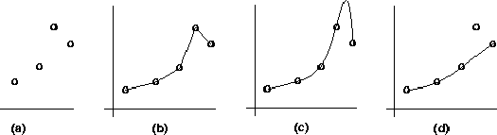
Inductive Learning and Bias
11.1 Introduction
11.2 Language of planning problem
11.3 Example of Air Cargo
11.4 The spare tire problem
11.5 Planning with state space
11.6 Partial order planning
11.7 Hierarchical planning
11.8 Conditional planning
11.9 Learning decision trees
11.10 Ensemble learning
11.11 Reinforcement learning
Suppose that we want to learn a function f(x) = y and we are given some sample (x,y) pairs, as in figure (a).
There are several hypotheses we could make about this function, e.g.: (b), (c) and (d).
A preference for one over the others reveals the bias of our learning technique, e.g.:
prefer piece-wise functions
prefer a smooth function
prefer a simple function and treat outliers as noise

Slide 75
R&Ns Restaurant Domain
11.1 Introduction
11.2 Language of planning problem
11.3 Example of Air Cargo
11.4 The spare tire problem
11.5 Planning with state space
11.6 Partial order planning
11.7 Hierarchical planning
11.8 Conditional planning
11.9 Learning decision trees
11.10 Ensemble learning
11.11 Reinforcement learning
Develop a decision tree to model the decision a patron makes when deciding whether or not to wait for a table at a restaurant.
Two classes: wait, leave
Ten attributes: alternative restaurant available?, bar in restaurant?, is it Friday?, are we hungry?, how full is the restaurant?, how expensive?, is it raining?,do we have a reservation?, what type of restaurant is it?, what's the purported waiting time?
Training set of 12 examples
~ 7000 possible cases

Slide 76
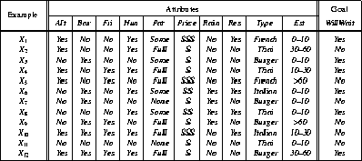
A Training Set
11.1 Introduction
11.2 Language of planning problem
11.3 Example of Air Cargo
11.4 The spare tire problem
11.5 Planning with state space
11.6 Partial order planning
11.7 Hierarchical planning
11.8 Conditional planning
11.9 Learning decision trees
11.10 Ensemble learning
11.11 Reinforcement learning

Slide 77
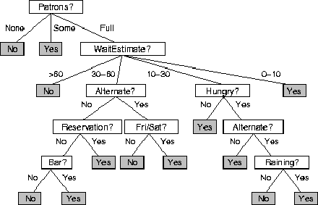
A decision Tree from Introspection
11.1 Introduction
11.2 Language of planning problem
11.3 Example of Air Cargo
11.4 The spare tire problem
11.5 Planning with state space
11.6 Partial order planning
11.7 Hierarchical planning
11.8 Conditional planning
11.9 Learning decision trees
11.10 Ensemble learning
11.11 Reinforcement learning

Slide 78
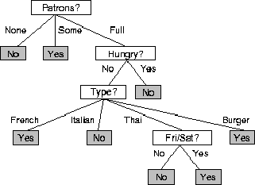
ID3 Induced Decision Tree
11.1 Introduction
11.2 Language of planning problem
11.3 Example of Air Cargo
11.4 The spare tire problem
11.5 Planning with state space
11.6 Partial order planning
11.7 Hierarchical planning
11.8 Conditional planning
11.9 Learning decision trees
11.10 Ensemble learning
11.11 Reinforcement learning

Slide 79
ID3
11.1 Introduction
11.2 Language of planning problem
11.3 Example of Air Cargo
11.4 The spare tire problem
11.5 Planning with state space
11.6 Partial order planning
11.7 Hierarchical planning
11.8 Conditional planning
11.9 Learning decision trees
11.10 Ensemble learning
11.11 Reinforcement learning
A greedy algorithm for Decision Tree Construction developed by Ross Quinlan, 1987
Consider a smaller tree a better tree
Top-down construction of the decision tree by recursively selecting the "best attribute" to use at the current node in the tree, based on the examples belonging to this node.
Once the attribute is selected for the current node, generate children nodes, one for each possible value of the selected attribute.
Partition the examples of this node using the possible values of this attribute, and assign these subsets of the examples to the appropriate child node.
Repeat for each child node until all examples associated with a node are either all positive or all negative.

Slide 80
Choosing the Best Attribute
11.1 Introduction
11.2 Language of planning problem
11.3 Example of Air Cargo
11.4 The spare tire problem
11.5 Planning with state space
11.6 Partial order planning
11.7 Hierarchical planning
11.8 Conditional planning
11.9 Learning decision trees
11.10 Ensemble learning
11.11 Reinforcement learning
The key problem is choosing which attribute to split a given set of examples.
Some possibilities are:
Random: Select any attribute at random
Least-Values: Choose the attribute with the smallest number of possible values (fewer branches)
Most-Values: Choose the attribute with the largest number of possible values (smaller subsets)
Max-Gain: Choose the attribute that has the largest expected information gain, i.e. select attribute that will result in the smallest expected size of the subtrees rooted at its children.
The ID3 algorithm uses the Max-Gain method of selecting the best attribute.

Slide 81
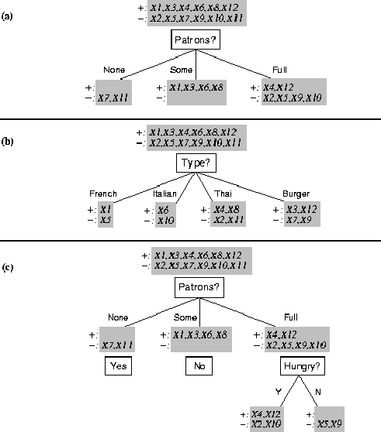
Splitting Examples by Testing Attributes
11.1 Introduction
11.2 Language of planning problem
11.3 Example of Air Cargo
11.4 The spare tire problem
11.5 Planning with state space
11.6 Partial order planning
11.7 Hierarchical planning
11.8 Conditional planning
11.9 Learning decision trees
11.10 Ensemble learning
11.11 Reinforcement learning

Slide 82
ID3 Induced Decision Tree
11.1 Introduction
11.2 Language of planning problem
11.3 Example of Air Cargo
11.4 The spare tire problem
11.5 Planning with state space
11.6 Partial order planning
11.7 Hierarchical planning
11.8 Conditional planning
11.9 Learning decision trees
11.10 Ensemble learning
11.11 Reinforcement learning

Slide 83
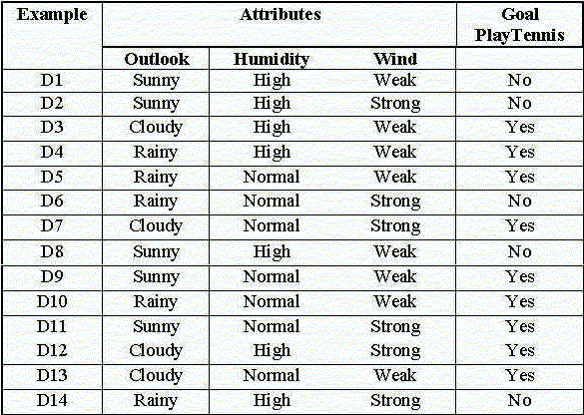
Another example: tennis anyone?
11.1 Introduction
11.2 Language of planning problem
11.3 Example of Air Cargo
11.4 The spare tire problem
11.5 Planning with state space
11.6 Partial order planning
11.7 Hierarchical planning
11.8 Conditional planning
11.9 Learning decision trees
11.10 Ensemble learning
11.11 Reinforcement learning

Slide 84
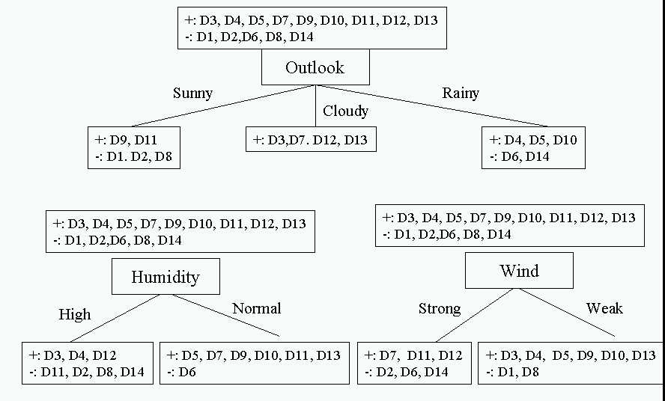
Choosing the first split
11.1 Introduction
11.2 Language of planning problem
11.3 Example of Air Cargo
11.4 The spare tire problem
11.5 Planning with state space
11.6 Partial order planning
11.7 Hierarchical planning
11.8 Conditional planning
11.9 Learning decision trees
11.10 Ensemble learning
11.11 Reinforcement learning

Slide 85
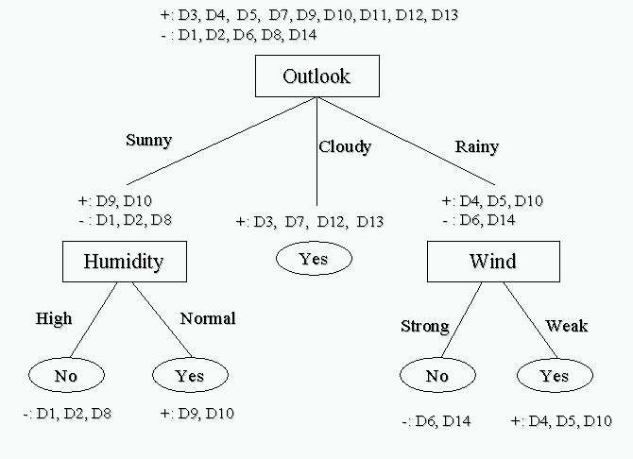
Resulting Decision Tree
11.1 Introduction
11.2 Language of planning problem
11.3 Example of Air Cargo
11.4 The spare tire problem
11.5 Planning with state space
11.6 Partial order planning
11.7 Hierarchical planning
11.8 Conditional planning
11.9 Learning decision trees
11.10 Ensemble learning
11.11 Reinforcement learning

Slide 86
Ensemble learning
11.1 Introduction
11.2 Language of planning problem
11.3 Example of Air Cargo
11.4 The spare tire problem
11.5 Planning with state space
11.6 Partial order planning
11.7 Hierarchical planning
11.8 Conditional planning
11.9 Learning decision trees
11.10 Ensemble learning
11.11 Reinforcement learning
So far we have looked at learning methods in which a single hypothesis, chosen from a hypothesis space, is used to make predictions. The idea of ensemble learning methods is to select a whole collection, or ensemble, of hypotheses from the hypothesis space and combine their predictions. For example, we might generate a hundred different decision trees from the same training set and have them vote on the best classification for a new example.
Another way to think about the ensemble idea is as a generic way of enlarging the hypothesis space. That is, think of the ensemble itself as a hypothesis and the new hypothesis space as the set of all possible ensembles constructible from hypotheses in the original space.

Slide 87


Reinforcement learning
11.1 Introduction
11.2 Language of planning problem
11.3 Example of Air Cargo
11.4 The spare tire problem
11.5 Planning with state space
11.6 Partial order planning
11.7 Hierarchical planning
11.8 Conditional planning
11.9 Learning decision trees
11.10 Ensemble learning
11.11 Reinforcement learning
The problem is that: without some feedback about what is good and what is bad, the agent will have no grounds for deciding which move to make. The agent needs to know that something good has happened when it wins and that something bad has happened when it loses. This kind of feedback is called a reward, or reinforcement.
Passive Reinforcement Learning
2. Direct Utility Estimation

Slide 88


Reinforcement learning
11.1 Introduction
11.2 Language of planning problem
11.3 Example of Air Cargo
11.4 The spare tire problem
11.5 Planning with state space
11.6 Partial order planning
11.7 Hierarchical planning
11.8 Conditional planning
11.9 Learning decision trees
11.10 Ensemble learning
11.11 Reinforcement learning
3. Adaptive Dynamic Programming: An adaptive dynamic programming (or ADP) agent works by learning the transition model of the environment as it goes along and solving the corresponding Markov decision process using a dynamic programming method.
4. Temporal Difference Learning
5. Active Reinforcement Learning
Here, a is the learning rate parameter.

Slide 89

Dr. Nilakshi Jain Email ID : nilakshijain1986@gmail.com
Thank you

